Slide 1

Exploratory Analysis
Benjamin Kraska
April 25th & May 8th 2020

Slide 2
Agenda
Introduction to NoSQL
Introduction to R
Python: NumPy & Pandas
Group by
Correlation
ANOVA

Slide 3
Group by

Slide 4
Group by
In tabular data, multiple rows often share some property
Example: Employees from the same department
Group by is used to apply some operation for each such group, e.g. average salary per department
Groups are formed by a group key, e.g. department ID
Afterwards an aggregation and / or a mapping takes place

Slide 5
Example
“How many senators per state?”
Steps in pandas:
Split: for each state, create a subtable with all rows of that state
Apply: Count the number of rows per subtable
Combine: Form a result with one row per state and the associated count
surname | state | gender
Bassett | CA | M
George | CA | F
Bland | TX | F
state | count
CA | 2
TX | 1

Slide 6
Step 1: Split
grouping key
surname | state | gender
Bassett | CA | M
George | CA | F
surname | state | gender
Bassett | CA | M
George | CA | F
Bland | TX | F
surname | state | gender
Bland | TX | F

Slide 7
Step 2: Apply
surname | state | gender
Bassett | CA | M
George | CA | F
state | count
CA | 2
surname | state | gender
Bland | TX | F
state | count
TX | 1

Slide 8
Step 3: Combine
state | count
CA | 2
state | count
CA | 2
TX | 1
state | count
TX | 1

Slide 9
Code in pandas
legislators.groupby(‘state’)[‘surname’].count()
SPLIT
APPLY / COMBINE

Slide 10
Exercise
Question: “What is the number of men and women?”
How would you solve this via grouping?
What is the group key?
What happens at each step (split / apply / combine)?
What do the subtables look like?
surname | state | gender
Bassett | CA | M
George | CA | F
Bland | TX | F
gender | count
M | 1
F | 2

Slide 11
Solution
apply
combine
split
surname | state | gender
Bassett | CA | M
gender | count
M | 1
surname | state | gender
Bassett | CA | M
George | CA | F
Bland | TX | F
gender | count
M | 1
F | 2
surname | state | gender
George | CA | F
Bland | TX | F
gender | count
F | 2

Slide 12
Step 2: Apply (revisited)
This kind of transformation is called an aggregation or narrow
Every subtable is transformed into a single row
surname | state | gender
Bassett | CA | M
George | CA | F
state | count
CA | 2
surname | state | gender
Bland | TX | F
state | count
TX | 1

Slide 13
Pivoting
Pivoting is an especially useful transformation
Useful when switching from e.g. person-level to state-level
Rows are converted into columns
surname | state | gender
Bassett | CA | M
George | CA | F
state | surname0 | surname1 | surname2
CA | Bassett | George | NaN
surname | state | gender
Bonomi | FL | F
Howard | FL | M
Stark | FL | M
state | surname0 | surname1 | surname2
TX | Bonomi | Howard | Stark

Slide 14
Other aggregation methods
.count() - number of non-NaN rows
.size() - number of rows
.sum() - sum within a column
.max() - maximum within column
.idxmax() - label of the row with the maximum value
.unique() - convert the unique values within a column into a list
.aggregate() - apply function to each column (default) or each row

Slide 15
Wide transformations
We can do any kind of transformation as long as information between subtables is not shared
Here: filter for females
Then capitalize the surname
And throw away the gender column
surname | state | gender
Bassett | CA | M
George | CA | F
Hunter | CA | F
surname | state
GEORGE | CA
HUNTER | CA
surname | state | gender
Bland | TX | F
surname | state
BLAND | TX

Slide 16
Filtering with wide transformations
Common use case: Filtering groups based on some group statistics
Here: Filter all states with at least one male senator
For this, filtering on individual rows is not sufficient, we need to look at entire groups
surname | state | gender
Bassett | CA | M
George | CA | F
Hunter | CA | F
state
CA
surname | state | gender
Bland | TX | F
state
empty subtable

Slide 17
Other wide transformations
.filter() - filter within groups
.first() - take first element within each group
.ffill() - fill missing values using the values from previous rows
.quantile() - take the x % largest / smallest values within a group
.cumsum() - cumulative sum over rows
.apply() - apply a custom function to each subtable

Slide 18
Colab: group by

Slide 19
Correlation

Slide 20
Correlation
Measures how two variables are related to another
Example: IQ and income have a positive correlation: an increase in IQ (mostly) corresponds to an increase in income
Can be a either a bad thing or a good thing for some ML algorithms
E.g. linear methods suffer a lot when there is high collinearity, i.e. columns with high correlations
On the other hand, predicting a variable is much easier if we have a feature that is highly correlated, e.g. predict temperature from time of day
Correlations can be used for feature selection

Slide 21
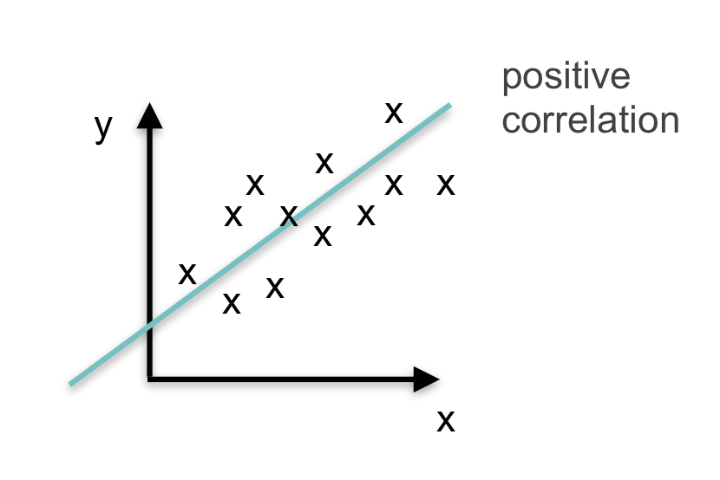
Examples
Some examples of data that have a high correlation:
Caloric intake and weight
Eye color and your relatives’ eye colors
The amount of time your study and your GPA
Example of negative correlation: physical exercise and body fat percentage

Slide 22
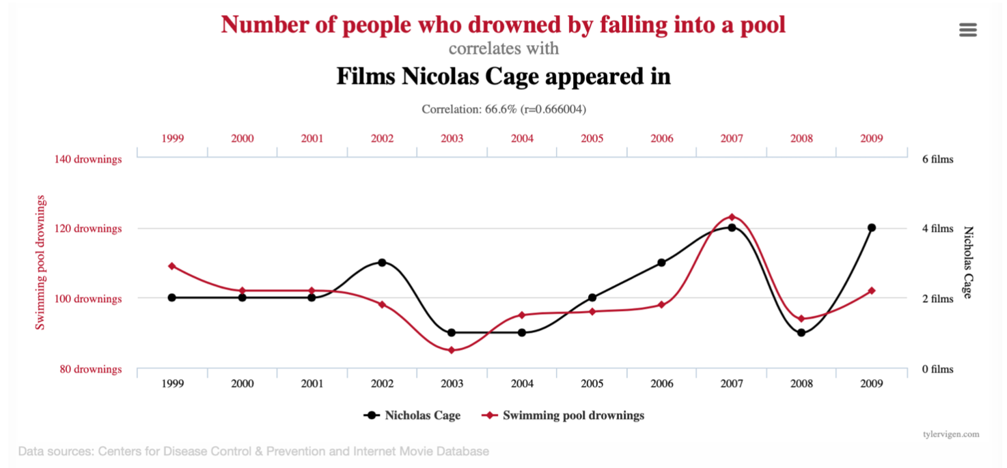
Correlation ≠ causation
If you search long enough, you will find ludicrous correlations
Overfitting is a related phenomenon in machine learning

Slide 23
Pearson correlation coefficient
The standard / default correlation
Measures linear associations between two variables
The sign indicates (anti-)monotonicity
Normalized to [-1.0, 1.0]

Slide 24
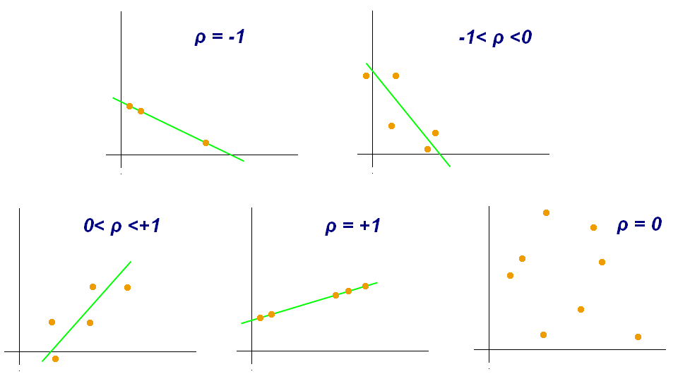
Pearson correlation coefficient
perfect fit, anti-monotonous
imperfect fit, anti-monotonous
imperfect fit, monotonous
uncorrelated
perfect fit, monotonous
By Kiatdd - Own work, CC BY-SA 3.0, https://commons.wikimedia.org/w/index.php?curid=37108966
Notes:
Plot bottom right:
Measuring a correlation of exactly zero is uncommon, in reality it would be somewhere close to zero
Correlation is an estimator with some error due to the sample being finite
Larger sample size => smaller error

Slide 25
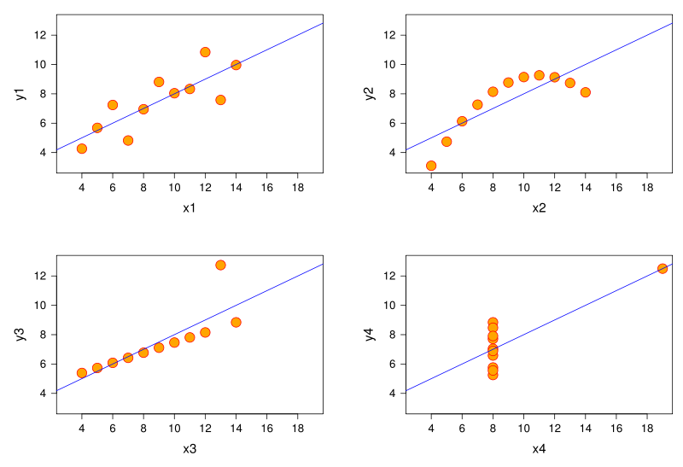
Caveats
Pearson correlation is 0.816 for all four plots
Yet the relationship is totally different
Plotting & outlier removal are important
non-linear relationship
outlier
By Anscombe.svg: Schutz(label using subscripts): Avenue - Anscombe.svg, CC BY-SA 3.0, https://commons.wikimedia.org/w/index.php?curid=9838454

Slide 26

Kendall’s tau
Captures any (anti-)monotonous relationship, not only linear
Normalized to [-1.0, 1.0]
If Y is an increasing function of X, their 𝛕 is 1.0
Calculated as
A pair of two samples (x₁, y₁), (x₂, y₂) is concordant if x₁ < x₂ and y₁ < y₂ or x₁ > x₂ and y₁ > y₂

Slide 27
Concordant pair
When x increases, y increases as well
Indicates monotonous relationship
These type of pairs increase Kendall’s tau
y₂
y₁
x₁
x₂

Slide 28
Discordant pair
When x increases, y decreases
Indicates anti-monotonous relationship
Decreases Kendall’s tau
y₁
y₂
x₁
x₂

Slide 29
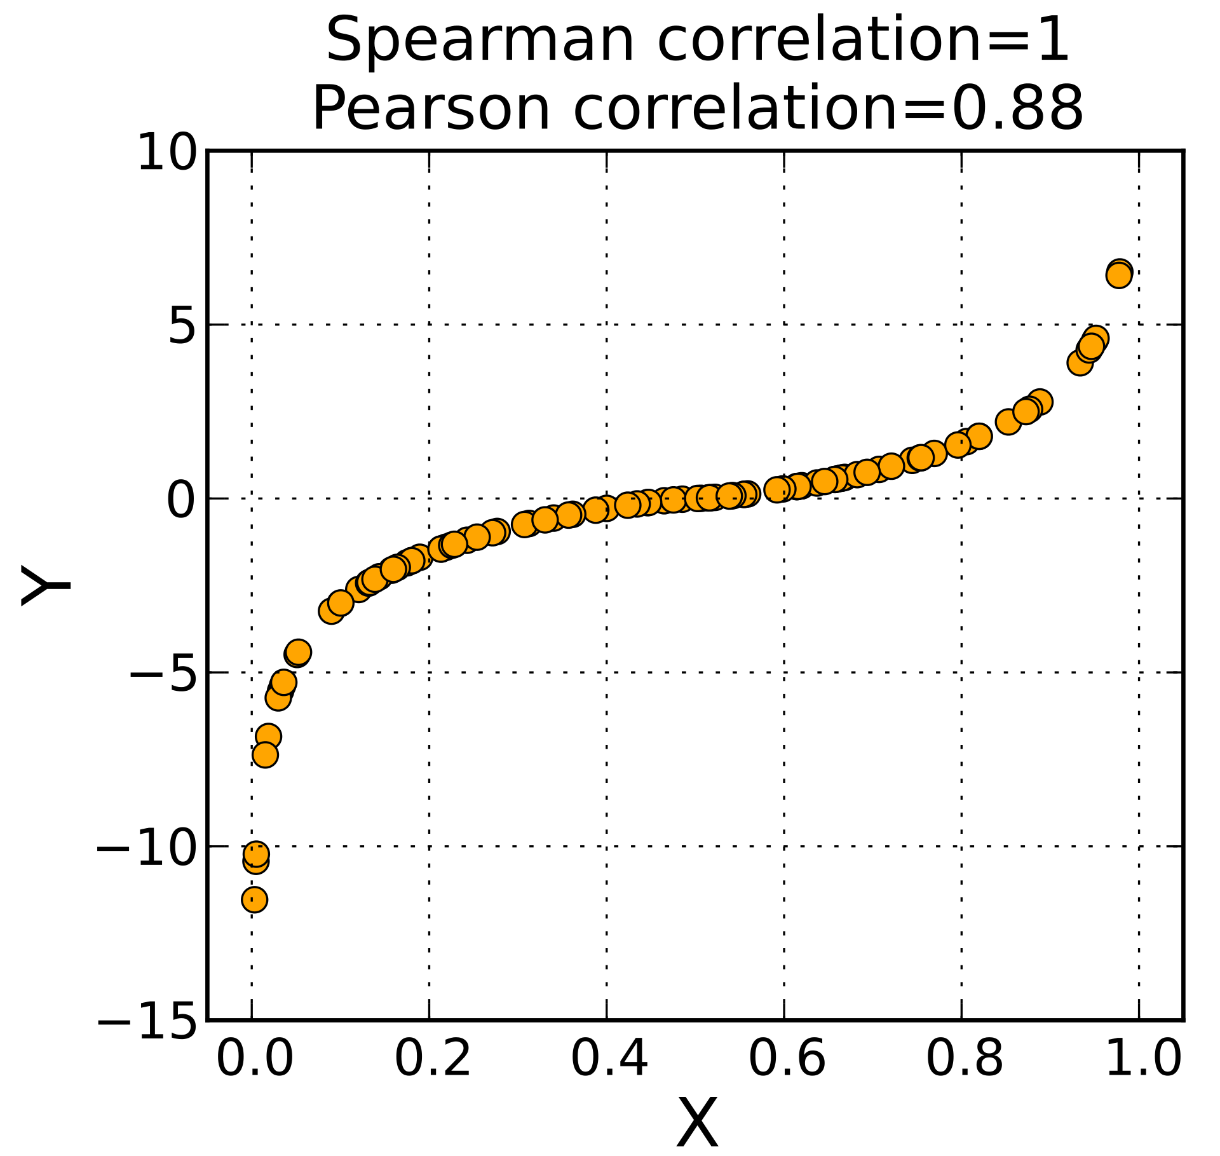
Spearman correlation
Like Kendall’s tau, measures any kind of monotonous relationship
Calculated via the (Pearson) correlation of ranks
By Skbkekas - Own work, CC BY-SA 3.0, https://commons.wikimedia.org/w/index.php?curid=8778554

Slide 30
Rank
Relative position of a value within all other values
Only the relative order matters, not the magnitude
X, Y have the same rank hence their Spearman correlation is 1.0
X
11.5
-3.0
-22
0
1
rank(X)
4
1
0
2
3
Y
1100
-3.5
-100
0.3
1.2
rank(Y)
4
1
0
2
3
By Skbkekas - Own work, CC BY-SA 3.0, https://commons.wikimedia.org/w/index.php?curid=8778554

Slide 31
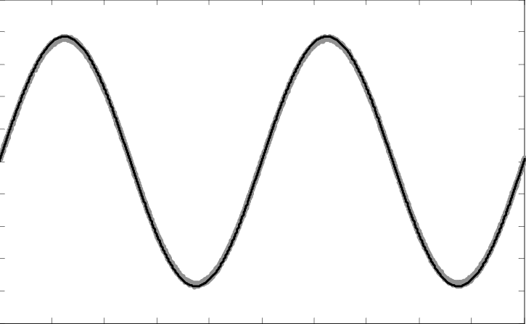
Mutual information
Measures how well Y can be predicted from X, regardless of monotonicity
sin(X) is neither an increasing nor a decreasing function of X, but has perfect mutual information with X

Slide 32
Homework solutions:
pandas groupby

Slide 33
ANOVA

Slide 34
Primer: Hypothesis tests
Used to answer questions about dataset such as:
“Does taking a certain drug have an effect on an illness?”
“Is intelligence quotient different between students of different subjects?”
“Which of several training regimen is best at improving athletic performance?”
“Is emotional intelligence normally distributed in the population?”
Hypotheses tests are a framework to answer these questions and to quantify the certainty of our results
Notes:
First question: Does taking… have an effect on an illness? Effect is here meant in the correlation not in the causation sense

Slide 35
Primer: Hypothesis tests
All hypothesis tests:
Take data with multiple observations as input
Data can have one or many variables, ordinal / metric -> depends on the test
Distinguish between a null hypothesis and an alternative hypothesis
Return a p-value / significance which means: How likely are we to see the observed results by chance if the null hypothesis holds true?

Slide 36
Primer: Hypothesis tests
Example of a hypothesis test: “Does taking a drug X increase libido?”
Our data could look something like this:
group | libido (1-7)
placebo | 1
drug | 7
drug | 6
placebo | 2
drug | 7
We have one categorial predictor / factor / IV (group membership)
And one metric outcome / DV (libido)
We can use a t-test to measure if there is a significant difference between the two groups

Slide 37
Kahoot time!

Slide 38
ANOVA
Can be seen as a generalization of the t-test for more than 2 levels
In the data below we now have four different levels for the factor ‘dose’
dose | libido (1-7)
placebo | 1
low dose | 2
high dose | 6
high dose | 7
low dose | 3
We see that subjects with ‘high dose’ have a higher libido than people with ‘placebo’ or ‘lower dose’
However there is also natural noise in the data
ANOVA quantifies our certainty for a significant effect

Slide 39
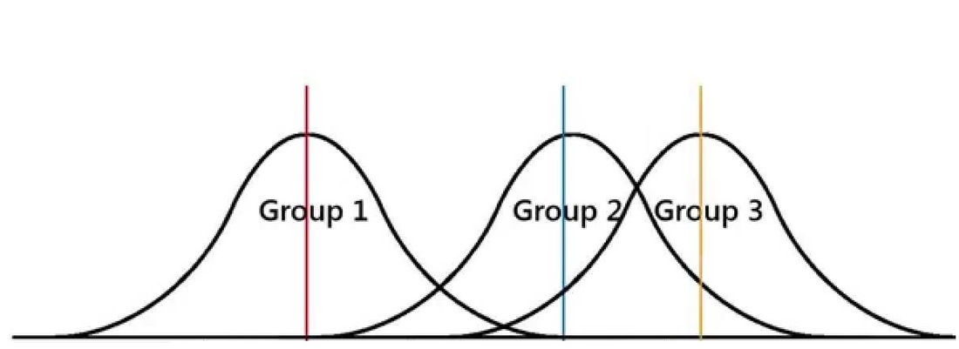
ANOVA
If the drug has a strong effect, we expect the medium libido to be much higher for the ‘high dose’ group than for the ‘low dose’ group
However, there is a natural variance within each group
ANOVA takes the variances within the groups into account when comparing the means
Hence the name ANOVA = Analysis of Variance
There are different flavors of ANOVA, e.g. one-way, two-way...

Slide 40
General framework for hypothesis tests
Frame the problem as a hypothesis test
Pick appropriate test
Check assumptions
Do the test
Analyze the test results, e.g. via post-hoc tests

Slide 41
Assumptions of ANOVA
Observations are sampled independently and are distributed identically (i.i.d.)
This would not be the case for e.g. repeated measurements on the same subject
Homogeneity of variance: Each group should have approximately equal variance -> Levene’s test, Brown-Forsythe test
Normality: variables must be distributed normally -> Shapiro-Wilk or Kolmogorov-Smirnov

Slide 42
Interpretation of ANOVA results
A p-value of less than 5% suggests there are differences in means between at least two groups
Specifically, it tells us that if all means were equal, observations as extreme as the dataset only occur in about 5% of cases
However, this does not tell us if the effect is positive, negative or something else
Doesn’t tell us which groups have a significant difference (ANOVA is an omnibus test)
To get more information, we need post-hoc tests
We use omnibus tests to keep the type I error low

Slide 43
Colab: Exploratory and inferential statistics

